Slide 1
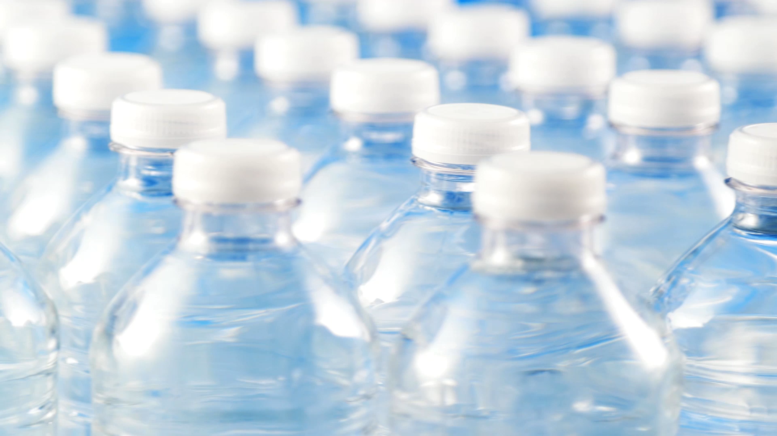
Acea Smart Water Analytics
Water flow depth prediction
TeaM:
Abdullah
Himanth
Shahiq

Slide 2
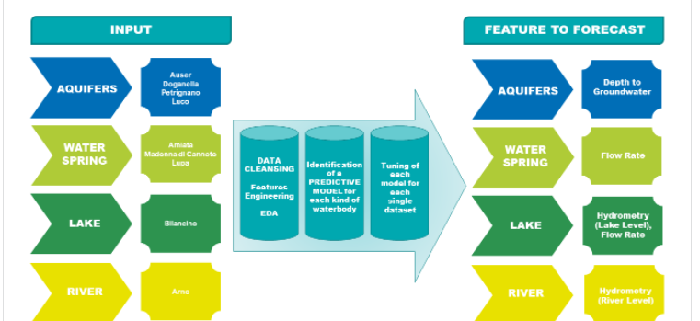
OBJECTIVE

Slide 3
Predicting waterbody depth and flow rate
Waterbody Type | Predicted Features
Aquifer | Depth of Groundwater
Lake | Lake Level, Flow Rate
Water Spring | Flow Rate
River | Hydrometry

Slide 4
Structure
Importing the datasets
EDA
Pre-processing
Features selection
Machine learning models
Prediction

Slide 5
Pre-processing (Feature Engineering)
Correlation Matrix with Heatmap
Handling missing values
Handling Outliers
Feature Scaling

Slide 6
Machine Learning models
Regression
Decision Tree
Extra Trees
Random Forest
AdaBoost
Skl GBM
XGBoost
LightGBM
CatBoost

Slide 7
Aquifer Auser

Slide 8
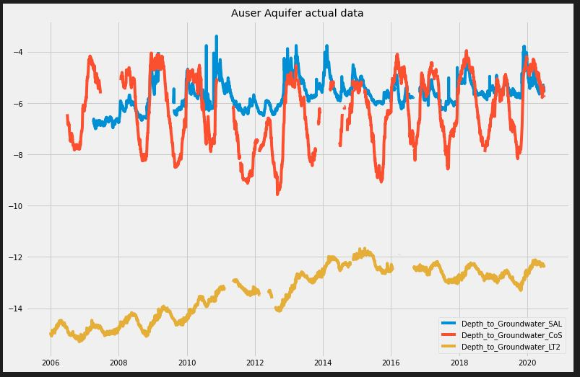

Slide 9
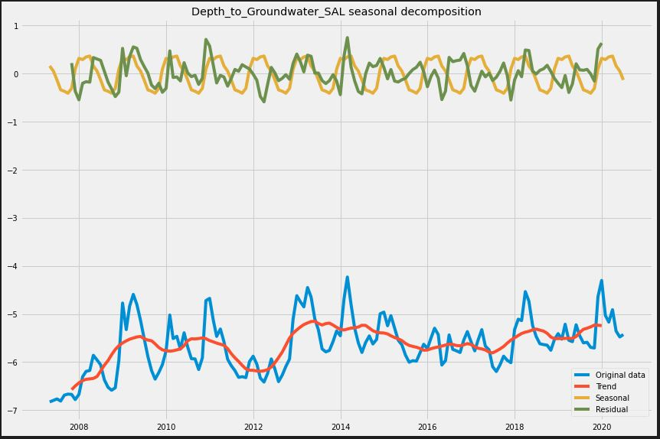

Slide 10
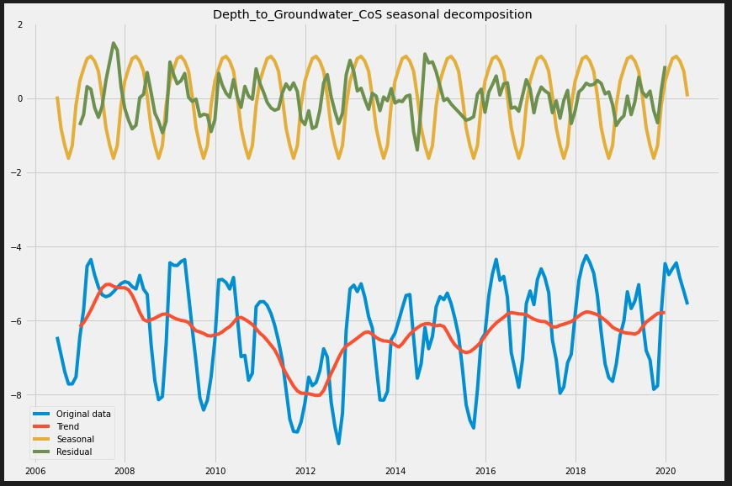

Slide 11
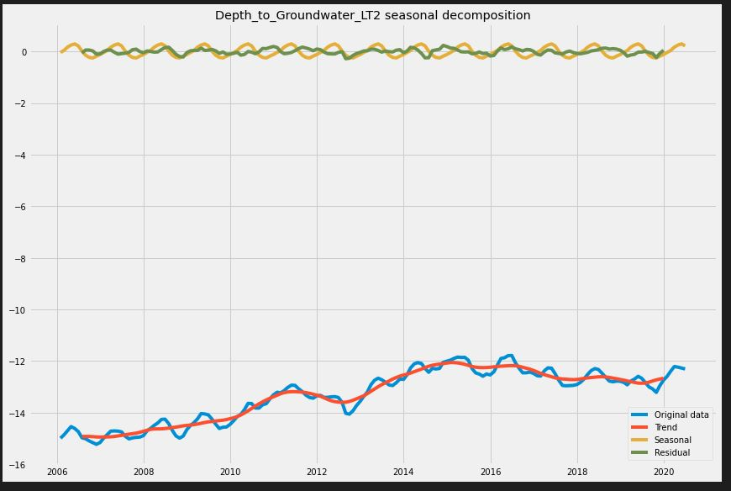

Slide 12
Bilancino lake

Slide 13
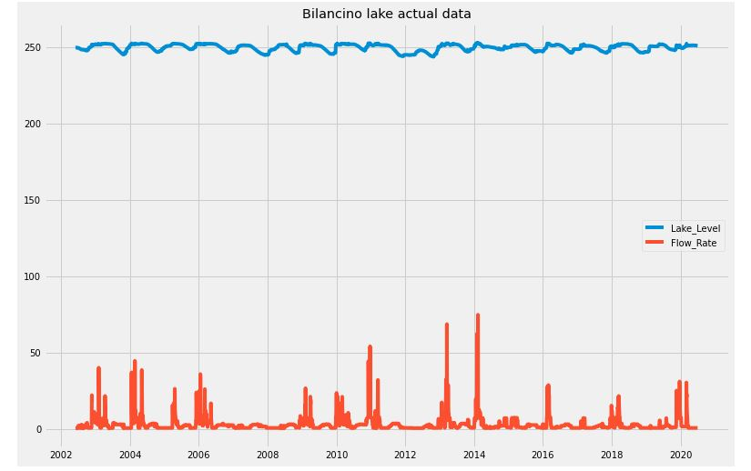

Slide 14
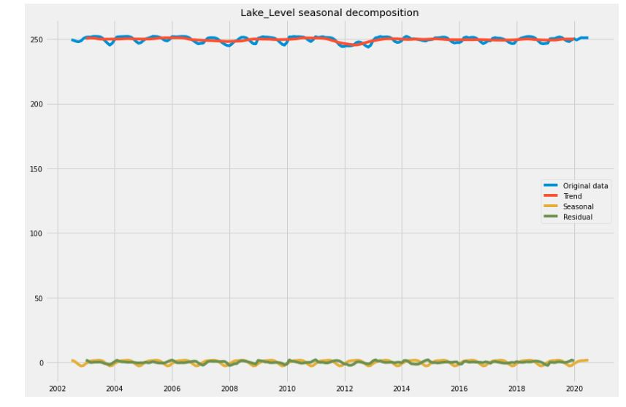

Slide 15
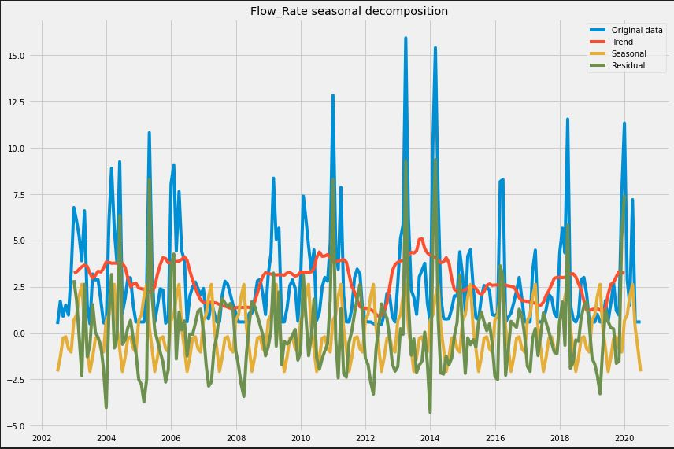

Slide 16
Waterspring AMIATA

Slide 17
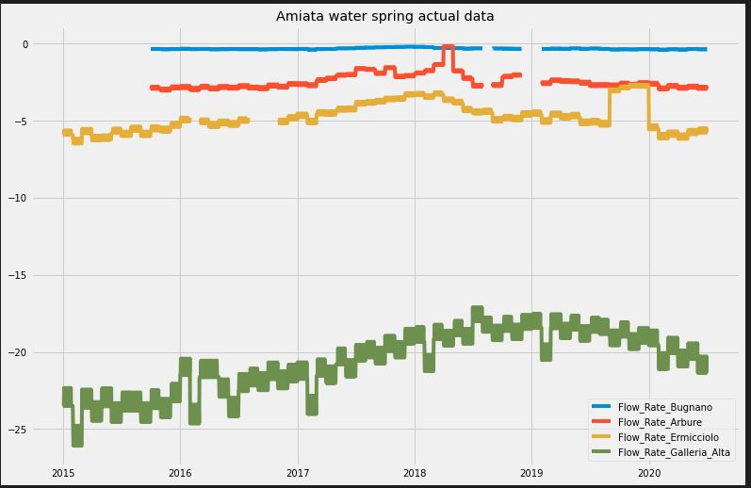

Slide 18
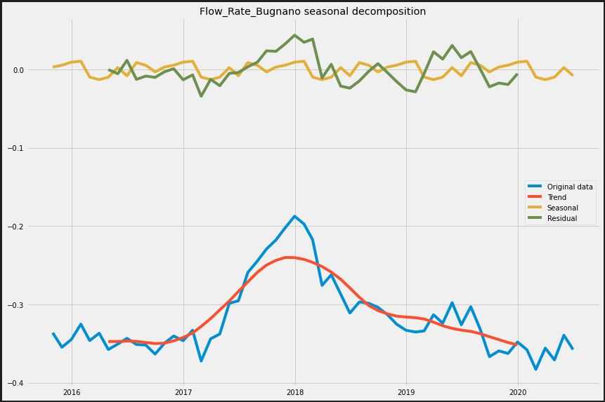

Slide 19
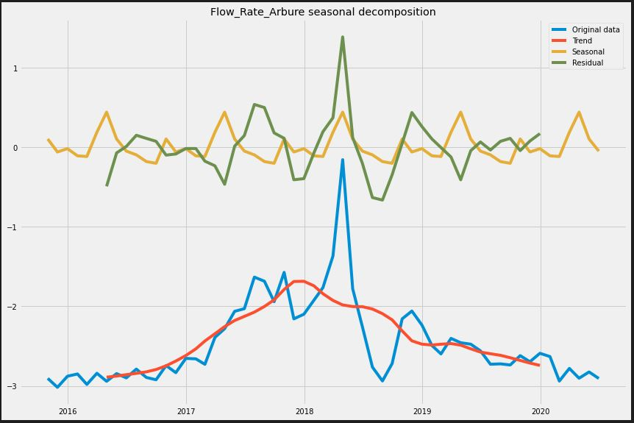

Slide 20
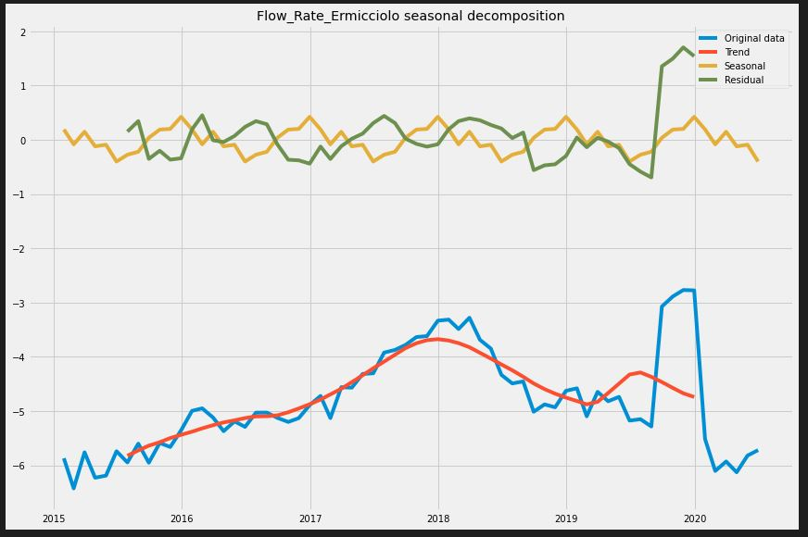

Slide 21
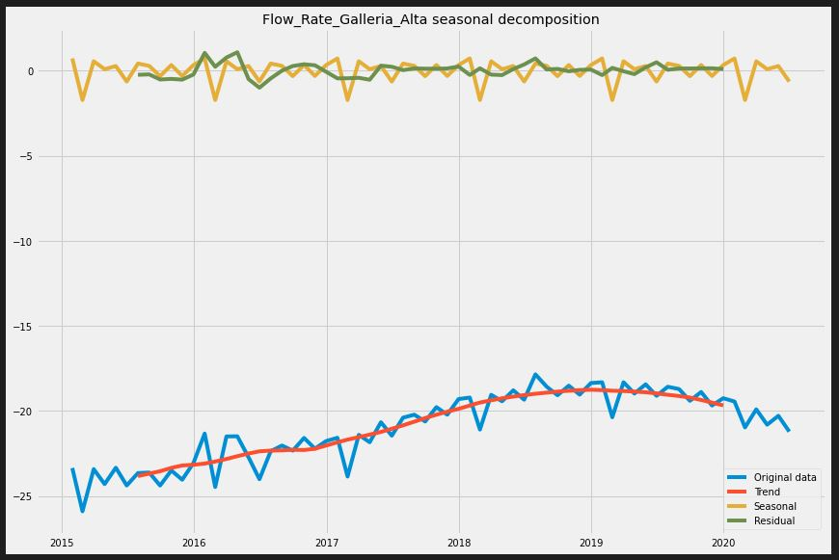

Slide 22
ANY QUESTIONS ??

Slide 23
Thank YOU ☺

